Slide 1
NA4 – The Transport and Application Layers
COMP 256 – Dickinson College
Prof. Braught
Spring 2023
Image from: https://dealna.com/Article/
Post/6564/Networking-Accessories

Slide 2
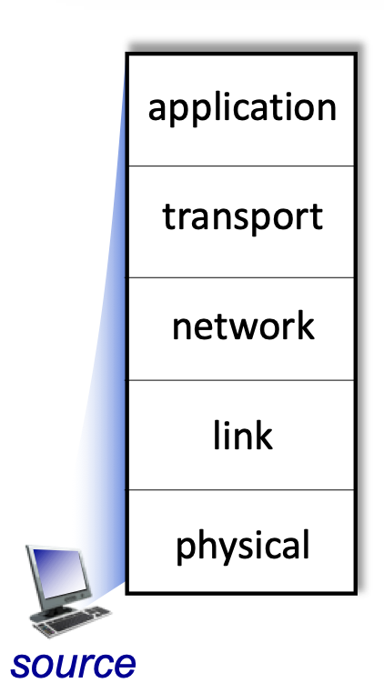
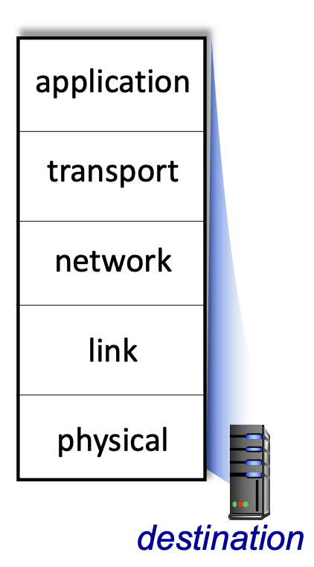
Bridging the Chasm: Network Layers
Getting information from one application to another.
Application Layer Service
HTTP
HTTP
TCP/
UDP
Transport Layer Services
TCP/
UDP
Source
Network Layer Services
Destination
IP
IP
Ether- net
Link Layer Services
Ether- net
Physical Layer Services
Wires
Wires
Image adapted from: http://gaia.cs.umass.edu/kurose_ross/videos/1/5/1.5_video_slides_posted.pptx

Slide 3
Network Data Encapsulation
Data
Data
Data
Data
Link Layer Info
Network Layer Info
Message
Transport Layer Info
Application
Layer Info

Slide 4
The Transport Layer

Slide 5
Transport Layer
Transport Layer:
OS adds/understands extra information to break message into smaller chunks (called packets), reassemble chunks into messages and deliver message to the target application on the destination machine.
Reliable delivery and congestion control via Transmission Control Protocol (TCP)
Unreliable delivery via User Datagram Protocol (UDP)
Image adapted from: http://gaia.cs.umass.edu/kurose_ross/videos/1/5/1.5_video_slides_posted.pptx
Notes:
Application Layer was like application
- writing note to other application
- placing it in the envelope with the destination machine and application written on it.
Transport Layer would be like:
- OS on source deciding the message is too large and breaking it into smaller chunks.
- Could have torn the message in two and put it into two envelopes and numbered them.
- Then put each of those in its own envelope labeled with the destination machine.
- OS at destination
- Collects packets and reassembles them into the message
- Delivers the message to the application.

Slide 6

Reliable Data Transfer: Abstraction
A reliable channel guarantees that the data that is sent is received (if possible).
The IP network layer is not reliable.
What types of data require reliable transfer?
What types do not?
Image adapted from: http://gaia.cs.umass.edu/kurose_ross/videos/3/3/3.3_UDP_video_slides.pptx
Notes:
If Possible – if there is no route then sorry…
- However, the sender will know if the data was not received.

Slide 7
Reliable Data Transfer: Implementation
Transmission
Control
Protocol
(TCP)
How do humans ensure reliable data transfer in conversation?
Image adapted from: http://gaia.cs.umass.edu/kurose_ross/videos/3/3/3.3_UDP_video_slides.pptx

Slide 8
ACK is the Answer!
Sender sends a packet and then waits for an acknowledgement (ACK).
When receiver successfully receives a packet it sends an ACK.
Image adapted from: http://gaia.cs.umass.edu/kurose_ross/videos/3/3/3.3_UDP_video_slides.pptx
Notes:
Successfully receives - all of the error detection stuff checks out.
- CRC in the Ethernet frame
- Internet checksum in the IP Datagram
- Internet checksum in the new Transport Layer Datagram

Slide 9
Lost or Corrupted Packets
If a packet is lost or corrupted the sender will not receive an ACK for it.
When sender does not receive the ACK for a packet before a timeout, it resends the packet.
Image adapted from: http://gaia.cs.umass.edu/kurose_ross/videos/3/3/3.3_UDP_video_slides.pptx

Slide 10
Lost or Corrupted ACK
If an ACK is lost the sender will not receive it or if it is corrupted the receiver will discard it.
Same as if the packet is not received. Timeout sends it again..
Image adapted from: http://gaia.cs.umass.edu/kurose_ross/videos/3/3/3.3_UDP_video_slides.pptx
Notes:
Delayed ACK and out of order reception scenarios would make good homework questions…. Guide them to extend what they know to cover those scenarios…

Slide 11
Reliable Data Transfer
What other types of things can happen? How might they be handled?

Slide 12
The Application Layer

Slide 13
Layer Responsibilities
Application Layer:
Programs exchange information using application specific messages that they understand.
E.g. A web browser talking to a web server.
Image adapted from: http://gaia.cs.umass.edu/kurose_ross/videos/1/5/1.5_video_slides_posted.pptx
Notes:
Application Layer was like application
- writing note to other application
- placing it in the envelope with the destination machine and application written on it.

Slide 14
HTTP: Hypertext Transfer Protocol
Uses for communication between Web Browsers and Web Servers.
Browser sends a message requesting a page or data.
Server receives the request and sends with a response with the page or data.
Browser receives the response.
Notes:
This is super short for now… but could build well upon the Web Server Lab assignment.

Slide 15
HTTP: Hypertext Transfer Protocol
Request:
Sent by browser: http://www.dickinson.edu/index.html
Received by server: GET /index.html HTTP/1.1
Notes:
Should look familiar from the Web Server assignment.

Slide 16
HTTP: Hypertext Transfer Protocol
Response from Server:
HTTP/1.1 200 OK Content-type: text/html <html> <head>…</html> <body>…</body> </html>
Notes:
This is what you generated…

Slide 17

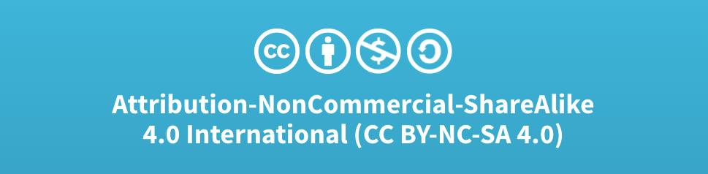
Acknowledgments
Slide Template From:
https://creativecommons.org/licenses/by/4.0/
Slide Content Licensed as:
Creative Commons Attribution-NonCommercial-ShareAlike 4.0 International License.
Notes:
Note: Individual images may be covered by their own licensing agreements and were incorporated here under fair use. Their use in this slide deck does not change or alter their licensing.

Slide 18
TCP segment structure
32 bits
source port #
dest port #
segment seq #: counting bytes of data into bytestream (not segments!)
ACK: seq # of next expected byte; A bit: this is an ACK
sequence number
acknowledgement number
length (of TCP header)
head
len
not
used
A
receive window
flow control: # bytes receiver willing to accept
C
P
E
S
U
R
F
Internet checksum
checksum
Urg data pointer
options (variable length)
C, E: congestion notification
TCP options
application
data
(variable length)
data sent by application into TCP socket
RST, SYN, FIN: connection management
Notes:
Add simplified version of this.
- keep ports
- sequence and ack numbers
- checksum
- length
- data / payload

Slide 19
TCP sequence numbers, ACKs
outgoing segment from sender
Sequence numbers:
byte stream “number” of first byte in segment’s data
source port #
dest port #
sequence number
acknowledgement number
rwnd
checksum
urg pointer
window size
N
Acknowledgements:
seq # of next byte expected from other side
cumulative ACK
sender sequence number space
sent
ACKed
sent, not-yet ACKed
(“in-flight”)
usable
but not
yet sent
not
usable
Q: how receiver handles out-of-order segments
A: TCP spec doesn’t say, - up to implementor
outgoing segment from receiver
source port #
dest port #
sequence number
acknowledgement number
A
rwnd
checksum
urg pointer
Notes:
Simplify this down to sequence number and ack

Slide 20

TCP sequence numbers, ACKs
Host A
Host B
User types‘C’
Seq=42, ACK=79, data = ‘C’
host ACKs receipt of‘C’, echoes back ‘C’
Seq=79, ACK=43, data = ‘C’
host ACKs receipt of echoed ‘C’
Seq=43, ACK=80
simple telnet scenario
Notes:
Possibly drop the data echo here since this is Telnet which would be application layer? OR do it there??
The key thing to note here is that the ACK number (43) on the B-to-A segment is one more than the sequence number (42) on the A-toB segment that triggered that ACK
Similarly, the ACK number (80) on the last A-to-B segment is one more than the sequence number (79) on the B-to-A segment that triggered that ACK

